Slide 1
Telmo Carvalho Executive-Director of EurOcean IOI Training Course on Governance for the Mediterranean and Eastern European Countries , Malta – 2nd December 2009
“EurOcean - Pushing towards the integration of European maritime information and the sharing of maritime research infrastructures”

Slide 2
Topics to address
Rationale
- International Context
- European Context
Integration of Information
EurOcean as an example of the concept of the Integrated Maritime Policy
- Overview
- Objectives
- Networking Activities
IOI Course, Malta – 2nd December 2009

Slide 3
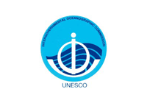
1.Rationale
INTERNATIONAL CONTEXT
Established in 1960, the Intergovernmental Oceanographic Commission of UNESCO promotes international cooperation and coordinates programmes in marine research, services, observation systems, hazard mitigation and capacity development in order to learn more and better manage the nature and resources of the ocean and coastal areas.
The International Oceanographic Data and Information Exchange (IODE), established in 1961, programme enhances the IOC marine research and management programmes by facilitating the exploitation, development, and exchange of oceanographic data and information between participating Member States and by meeting the needs of users for data and information products.
IOI Course, Malta – 2nd December 2009

Slide 4
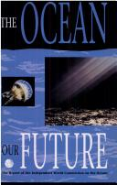
1.Rationale
INTERNATIONAL CONTEXT
Report “The Ocean our Future”
Independent World Commission on the Oceans (1998)
“...how to transform an aggregate of sectoral institutions existing at the national and international levels into a flexible and dynamic network that is responsive to the goals of solidarity and sustainability and to our growing knowledge of ecological linkages.”
IOI Course, Malta – 2nd December 2009

Slide 5
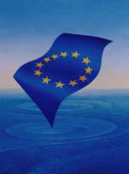
1.Rationale
EUROPEAN CONTEXT
Report “Towards a new marine dimension for Europe through research and technological development”
Working Group of governmental experts from 15 European countries brought together at the invitation of the Portuguese Minister for Science and Technology
This report, which was presented to the European Council for Research on 15th June 2000, recognised "the benefit of a focal point for information on marine science and technology, which could:
facilitate access to relevant information;
provide access to and develop marine quantitative indicators, including socio-economic data;
compile and prepare information on trends on marine S&T;
help prepare synthesis to decision-makers;
facilitate access to information to enhance cooperation between scientific and technological institutions, industry and other stakeholders;
contribute to public awareness and educational programmes on marine issues."
IOI Course, Malta – 2nd December 2009

Slide 6
1.Rationale
EUROPEAN CONTEXT
CREATION
In February 2002 the European Centre for Information on Marine Science and Technology is created in result of a joint French-Portuguese initiative aiming to implement the recommendations of the report "Towards a new marine dimension for Europe through research and technological development.
OBJECTIVES
To facilitate access to and to compile relevant information on marine science and technology at national and European levels.
To encourage communication and cooperation between the European organisations with activities in marine research.
To prepare analyses, reports and other products.
IOI Course, Malta – 2nd December 2009

Slide 7
1.Rationale
EUROPEAN CONTEXT
European Commission
DG RTD
DG Mare
DG Environment
An Integrated Maritime Policy for the European Union (October 2007)
Marine Strategy Framework Directive (June 2008)
EU Strategy for Marine and Maritime Research (September 2008)
IOI Course, Malta – 2nd December 2009

Slide 8
1.Rationale
EUROPEAN CONTEXT
DG Mare
An Integrated Maritime Policy for the European Union (October 2007)
“Strengthening the interdisciplinary approach to marine science can help us better understand the interactions between maritime activities, and will therefore be an indispensable component of an integrated maritime policy.”
So the commission will “Support the creation of a European marine science partnership for a concerted dialogue between the scientific community, the industry and policy makers.”
IOI Course, Malta – 2nd December 2009

Slide 9
1.Rationale
EUROPEAN CONTEXT
Marine Strategy Framework Directive (June2008)
DG RTD
DG Environment
“This Directive establishes a framework within which Member States shall take the necessary measures to achieve or mantain good environmental status in the marine environment by the year 2020 at the latest”
In the Framework of the implementation of this Directive three working groups were created that have three levels of intervenient – European Commission; member states and Stakeholders following the disposition in Art. 19 that requires public consultation and information.
- Working Group on Good Environmental Status;
- Marine Strategy Coordination Group;
- Working Group on data, information and knowledge exchange.
IOI Course, Malta – 2nd December 2009

Slide 10
1.Rationale
EUROPEAN CONTEXT
DG RTD
EU Strategy for Marine and Maritime Research (September 2008)
Addressing the oceans and seas systems complexity through:
Development of capacity building
Enhanced integration in research across marine and maritime disciplines
Integration across marine and maritime research disciplines
Integration and efficient use of marine data bases
Optimise use of existing research infrastructures
Strengthen long-lasting regional clusters
Foster knowledge & technology transfer
Better synergies between Member States, regions and industry
IOI Course, Malta – 2nd December 2009

Slide 11
2. Integration of Information
EUROPEAN CONTEXT
DG RTD
FP7
INSTRUMENTS...
DG MARE
EMODNET
European ATLAS of the SEAS
DG ENVIRONMENT
WISE Marine
IOI Course, Malta – 2nd December 2009

Slide 12
2. Integration of Information
DG MARE
EUROPEAN CONTEXT
EMODNET - European Marine Observation and Data Network
Networking facility for maximizing added value from potentially any marine observation and data, supporting the 'services' dimensions of maritime sectors and the knowledge base of the maritime Policy.
Focus on becoming a 'data warehouse' for marine observations for all types of users.
Regionally coherent, streamlined, raw data sets accessible to all potential users.
Discovery, viewing, retrieving. Extensive post-processing (into information products) not intended.
Source: EC Commission/ DG MARE website
IOI Course, Malta – 2nd December 2009

Slide 13
2. Integration of Information
DG ENVIRONMENT
EUROPEAN CONTEXT
WISE MARINE - Water Information System for Europe
European portal for marine environmental information, in line with SEIS (Shared Environmental Information System); Streamlined official reporting channel, reference centre for thematic marine environmental information
Focus on becoming a 'common reporting and information sharing' facility for communities in the sphere of marine environmental policy.
Prioritized entry levels in WISE-Marine are:
1. Indicators and thematic assessments;
2. Access to underlying data;
3. Interpretation in order to derive environmental meaning from data.
Source: EC Commission/ DG MARE website
IOI Course, Malta – 2nd December 2009

Slide 14
2. Integration of Information
DG RTD
EUROPEAN CONTEXT
FP7 Instruments
ERA-NETS - The ERA-NET scheme aims at developing and strengthening the coordination of national and regional research programmes in two ways: - providing a framework for actors implementing public research programmes to improve coordination through new ERA-NETs or by broadening and deepening existing ERA-NETs; and - providing, in a limited number of cases, additional EU financial support to participants who create a common fund for the purpose of joint calls for proposals among national and regional programmes (‘ERA-NET PLUS’).
Ex. for the marine sector: SEAS-ERA and CIRCLE II
Research Infrastructures/Capacities Programme
The overall objective of the ‘Research infrastructures’ part of the FP7 Capacities programme is to optimise the use and development of the best research infrastructures existing in Europe.
Ex. for the marine sector: EUROFLEETS
Article169
Actions under Article 169 aim at integrating parts of national and regional programmes for implementing jointly, together with the Commission, a real European research programme.
Ex. for the marine sector: BONUS 169
IOI Course, Malta – 2nd December 2009

Slide 15
3. EurOcean as an example of the concept of the Integrated Maritime Policy
MODUS OPERANDI
Since December 2007 EurOcean has been established, in the Netherlands, as a Stichting Foundation with a legal representation in Portugal.
The Centre cooperates with its Members as well as with the competent structures existing at national and European levels through networking of activities.
The financial and technical support of the Centre is provided by the Member and Cooperating Organisations.
A permanent Office is located in Lisbon, allowing a continuity of all the activities.
IOI Course, Malta – 2nd December 2009

Slide 16
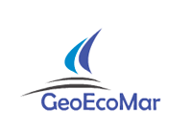
3. EurOcean as an example of the concept of the Integrated Maritime Policy
MEMBERS
12 full Member Organisations from 9 European countries. Membership is open.
2 Cooperating Members (CPMR and IOC)
IOI Course, Malta – 2nd December 2009

Slide 17
3. EurOcean as an example of the concept of the Integrated Maritime Policy
KEY DEFINITIONS
www.eurocean.org
Information
Knowledge obtained from analytical processes of sets of data and descriptors in manner suitable for dissemination and communication.
Infobase
Electronic set of information which has been aggregated and organised in a coherent and useful manner for end-users.
IOI Course, Malta – 2nd December 2009

Slide 18
3. EurOcean as an example of the concept of the Integrated Maritime Policy
MAIN INFOBASES
IOI Course, Malta – 2nd December 2009

Slide 19
3. EurOcean as an example of the concept of the Integrated Maritime Policy
MAIN INFOBASES / EurOcean_RV
www.rvinfobase.eurocean.org
IOI Course, Malta – 2nd December 2009

Slide 20
3. EurOcean as an example of the concept of the Integrated Maritime Policy
MAIN INFOBASES / EurOcean_UV
www.uvinfobase.eurocean.org
IOI Course, Malta – 2nd December 2009

Slide 21
3. EurOcean as an example of the concept of the Integrated Maritime Policy
MAIN INFOBASES / EurOcean_LExI
https://eurocean.imr.no/euroceandb/
IOI Course, Malta – 2nd December 2009

Slide 22
3. EurOcean as an example of the concept of the Integrated Maritime Policy
MAIN INFOBASES / EurOcean_MaP
www.mapinfobase.eurocean.org
IOI Course, Malta – 2nd December 2009

Slide 23
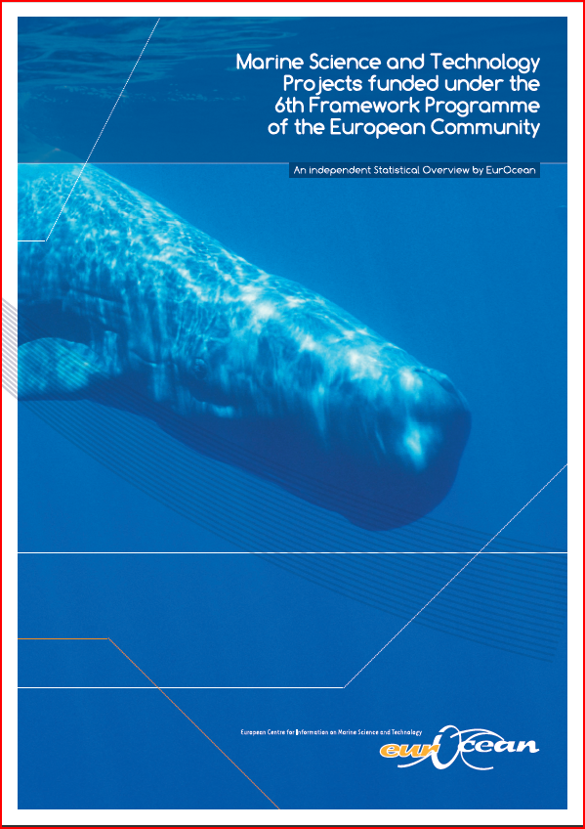
3. EurOcean as an example of the concept of the Integrated Maritime Policy
PRODUCTS
Marine Science and Technology Projects funded under the 6th Framework Programme of the European Community
A statistical report that is a contribution of EurOcean to the clarification of the funds dedicated to Marine Research in the 6th FP and the evolution of marine research trough the previous FP.
IOI Course, Malta – 2nd December 2009

Slide 24
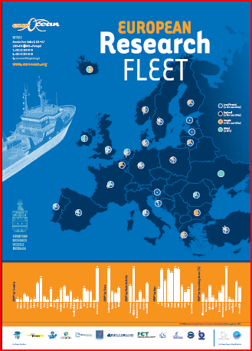
3. EurOcean as an example of the concept of the Integrated Maritime Policy
PRODUCTS
European Research Fleet Poster
Geo-statistical “snapshot” of the status of the European research fleet, which provides indicators such as: number of vessels by country, by class, by age and by operating area both at national and European level.
IOI Course, Malta – 2nd December 2009

Slide 25
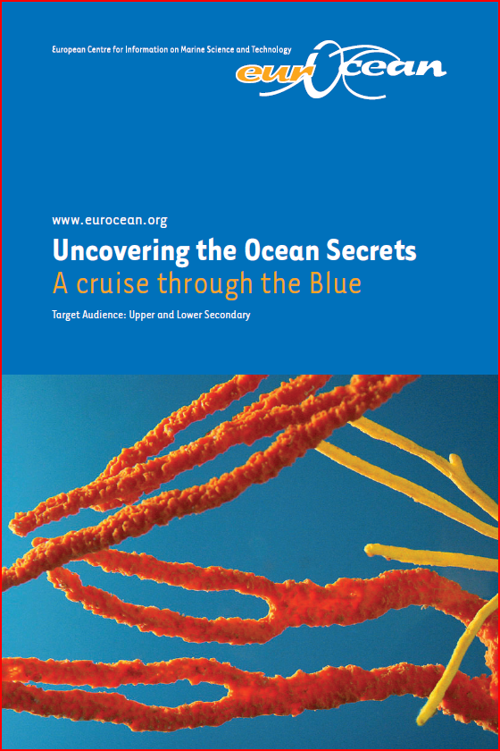
3. EurOcean as an example of the concept of the Integrated Maritime Policy
PRODUCTS
Uncovering the Ocean Secrets
A cruise trough the Blue
An Educational brochure, aimed at the secondary level students, that is the first result of a new line of work that has been developed by EurOcean.
IOI Course, Malta – 2nd December 2009

Slide 26
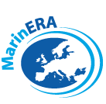
3. EurOcean as an example of the concept of the Integrated Maritime Policy
NETWORKING ACTIVITIES / FP6 ERA-NETS
IOI Course, Malta – 2nd December 2009

Slide 27
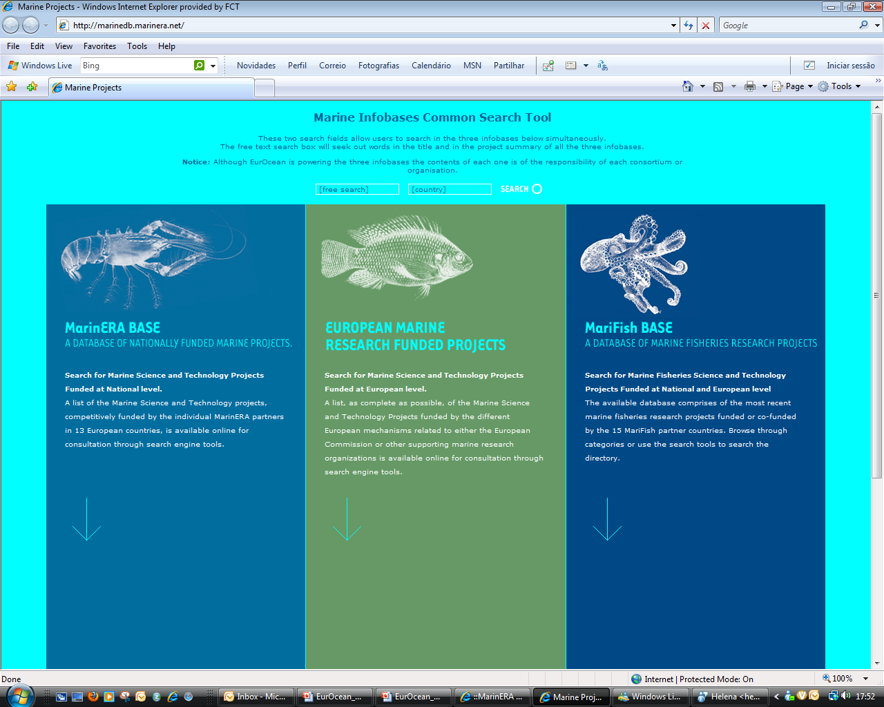
3. EurOcean as an example of the concept of the Integrated Maritime Policy
NETWORKING ACTIVITIES / INTEGRATION OF INFORMATION
IOI Course, Malta – 2nd December 2009

Slide 28
3. EurOcean as an example of the concept of the Integrated Maritime Policy
NETWORKING ACTIVITIES / COOPERATION WITH EUROPEAN INITIATIVES
IOI Course, Malta – 2nd December 2009

Slide 29
3. EurOcean as an example of the concept of the Integrated Maritime Policy
NETWORKING ACTIVITES / RESEARCH INFRASTRUCTURES
Towards an Alliance of the European Research Fleet
NETWORKING ACTIVITES / COORDINATION ACTION
Knowledge transfer and uptake of EU-research results
IOI Course, Malta – 2nd December 2009

Slide 30
3. EurOcean as an example of the concept of the Integrated Maritime Policy
NETWORKING ACTIVITES / ERA -NETS
“Towards integrated European marine research strategy and programmes”
SEAS-ERA
Climate Impact Research (and Response) Coordination for a Larger Europe
CIRCLE II ERA-Net
IOI Course, Malta – 2nd December 2009

Slide 31
Thank you
for your attention
eurocean@fct.mctes.pt
31
IOI Course, Malta – 2nd December 2009

